Slide 1



A Mars Rover For Studying The Subsurface Areas Using Seismic Exploration
Authors: Yenlik Maman , Saniya Shokhan
Grade: 11
Team: LikiSanctum

Slide 2

Project relevance
Our Place in the Universe
Leading countries around the world are developing plans to land humans on nearby celestial bodies, such as the Moon and Mars.
•For example, the United States is developing the Artemis mission to return to the Moon, while China is successfully advancing the Chang’e program for the systematic exploration of the Moon, as well as the Tianwen-3 mission for the study of Mars

Slide 3
Aim of the project
The aim of this project is to develop an autonomous robot for the exploration of subsurface structures in the vicinity of these pits using seismic surveying methods , because orbital imaging of the Moon and Mars has revealed the presence of vertical pits on their surfaces, which may represent entrances to lava tubes formed as a result of intense volcanic activity. These tubes could serve as ideal shelters from cosmic radiation for future colonies.

Slide 4
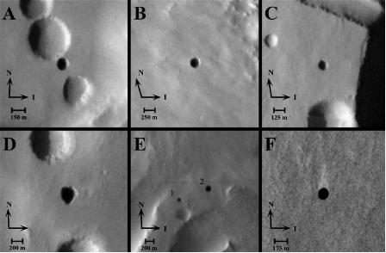
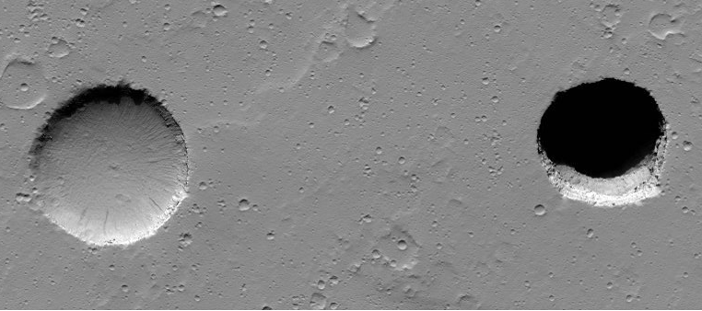
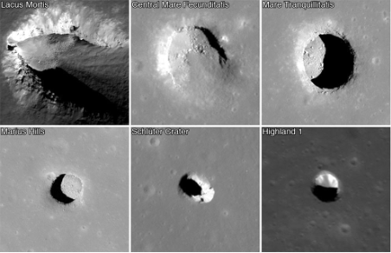
pits on the surface of the planet
Figure 1 Pits on Mars: (A) Dena,
(B)Chloe, (C) Wendy, (D) Annie, (E)
Abby and Nikki, (F) Jeanne
Figure 3 Difference between a typical crater and a pit
Figure 2 Pits on the surface of the Moon
•THESE STRUCTURES COULD EXTEND FOR MANY KILOMETERS, BUT THEIR ACTUAL EXISTENCE HAS NOT YET BEEN CONFIRMED.

Slide 5
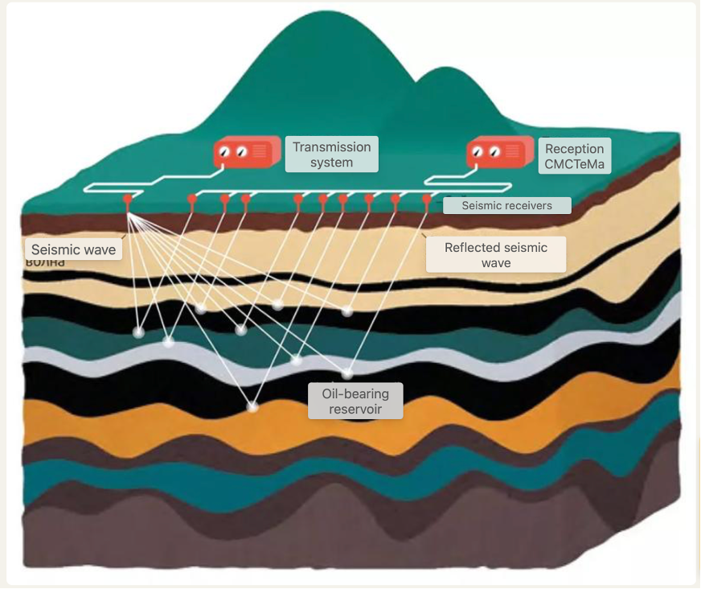
Seismic Surveying
Seismic Surveying
THE BEST APPROACH FOR SRUDYING GEOLOGICAL STRUCTURE OF MARS WITH MINIMAL FINANCIAL COSTS IS SEISMIC SURVEYING
•This method allows us to learn about the structure of caves without entering them, as all research can be carried out entirely from the surface. For this purpose, it is most practical to use an autonomous robot.

Slide 6
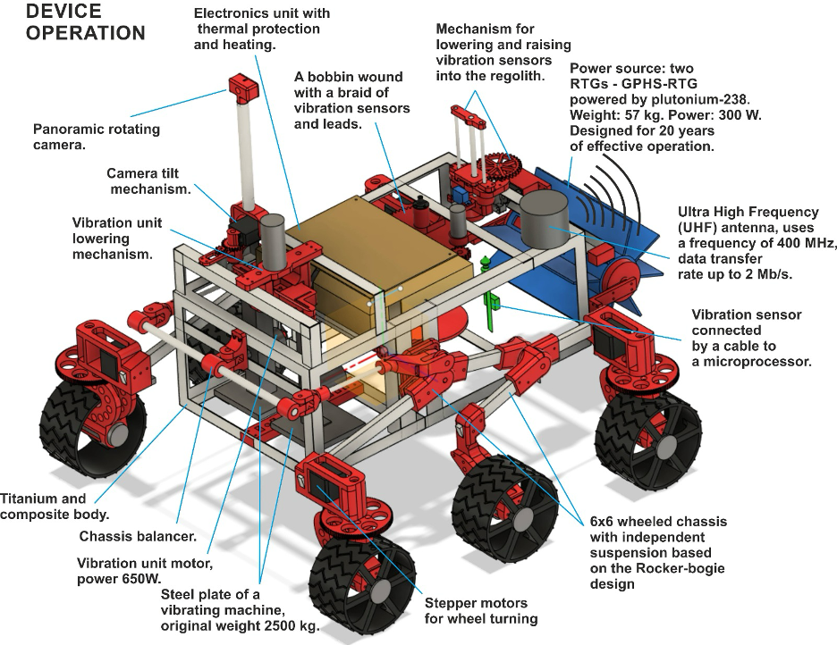
Engineering Marvel: Building a Mars Rover
FULLY FUNCTIONAL PROTOTYPE OF A ROBOTIC SYSTEM FOR SEISMIC EXPLORATION OF THE MARTIAN SUBSURFACE. THE PROPOSED SYSTEM IS INTENDED TO INVESTIGATE DEPTHS OF UP TO 100 METERS, AS THIS RANGE IS CONSIDERED THE MOST PROMISING FOR THE DETECTION OF POTENTIAL LAVA FORMATIONS.

Slide 7
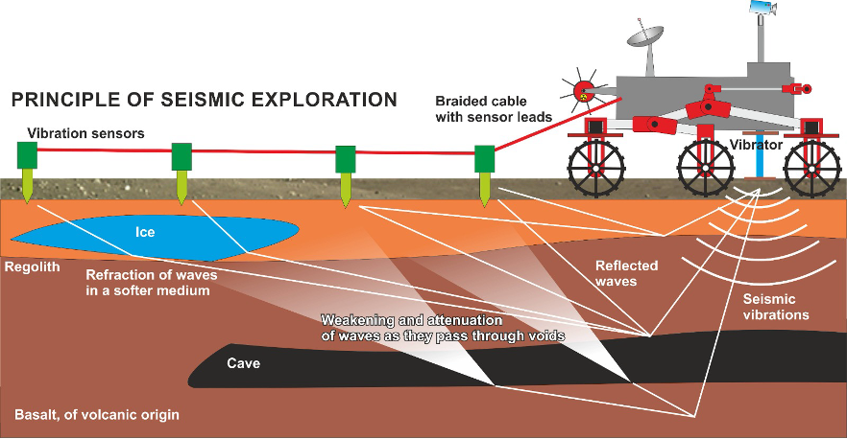
1. THE ROBOT LANDS IN AN AREA WHERE THERE ARE GROUND DEPRESSIONS AND POSSIBLE CAVE ENTRANCES. THE LANDING SITE WILL BE LOCATED APPROXIMATELY 1 KILOMETER FROM THE DEPRESSION, AFTER WHICH THE ROBOT AUTONOMOUSLY TRAVELS TO THE RESEARCH LOCATION.
2. At the research site, the robot moves forward, unspooling a cable, and uses a special mechanism to install vibration sensors into the regolith at intervals of every 5 meters. The sensors are placed in a line, positioned perpendicular to the assumed direction of the hypothetical cave.
3. After installing all the sensors, the robot lowers a seismic vibrator onto the regolith and pRESSES IT DOWN USING ITS OWN WEIGHT.
4. THE ROBOT ACTIVATES THE SEISMIC VIBRATOR. SEISMIC WAVES PROPAGATE TO DEPTHS OF UP TO 100 METERS, REFLECT OFF INTERNAL STRUCTURES, AND ARE DETECTED BY THE SEISMIC SENSORS.
5. EACH SENSOR TRANSMITS DATA TO A MICROCONTROLLER, AND THE COLLECTED DATA IS THEN SENT TO EARTH FOR DETAILED ANALYSIS.
6. ONCE EXPLORATION IN THIS DIRECTION IS COMPLETED, THE ROBOT RETURNS AND USES THE SAME MECHANISM TO RETRIEVE THE SENSORS AND WIND THE CABLE BACK ONTO THE SPOOL.
7. THE ROBOT THEN MOVES TO ANOTHER SECTOR AND REPEATS THE EXPLORATION PROCESS.
operating principle of the robot

Slide 8



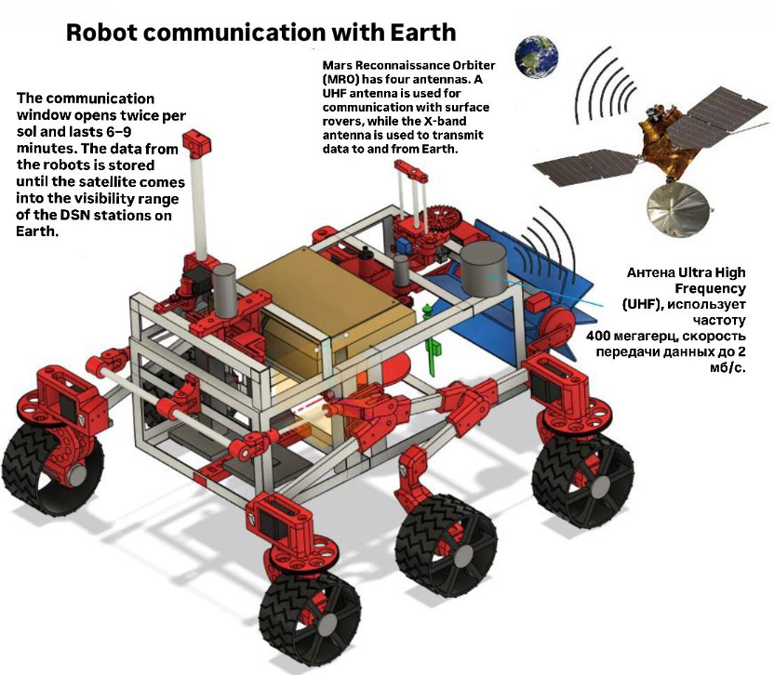




Robot Communication with Earth
LikiSanctum

Slide 9
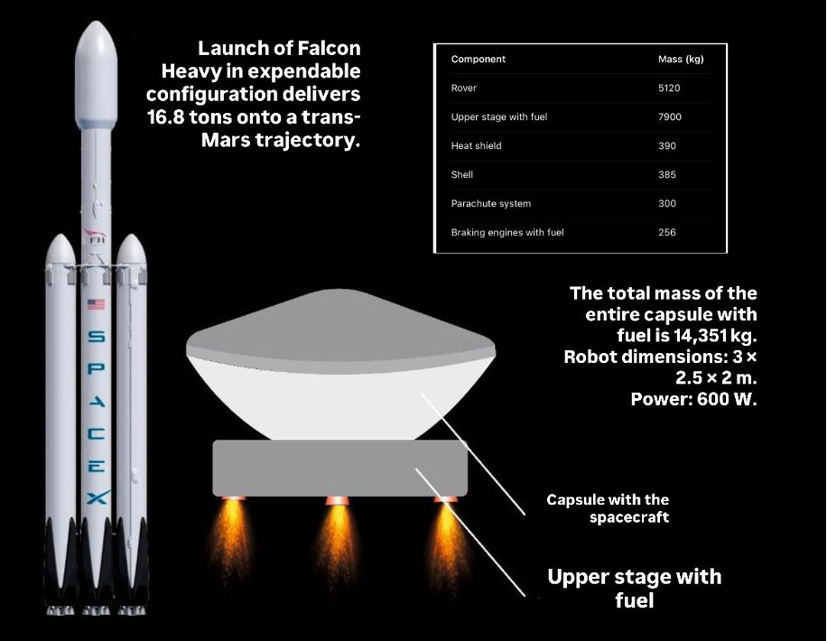
Mission Launch Calculations
LikiSanctum

Slide 10
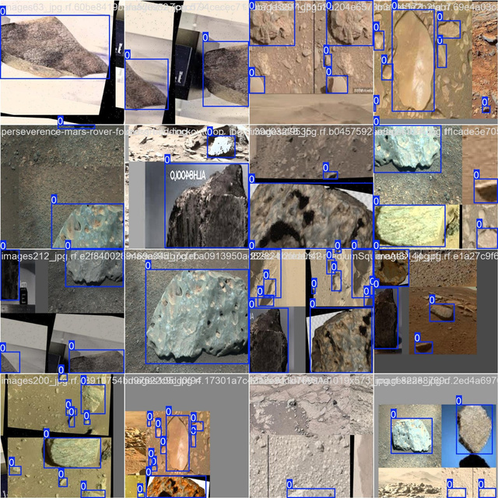
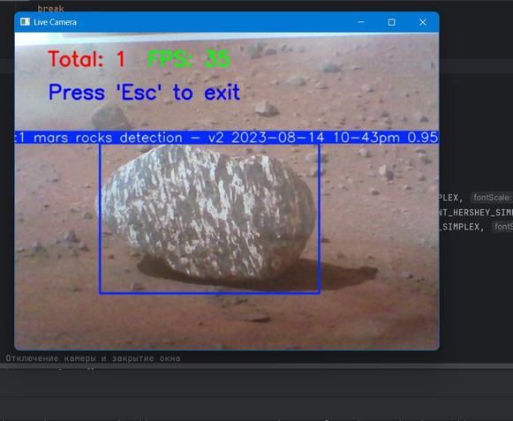
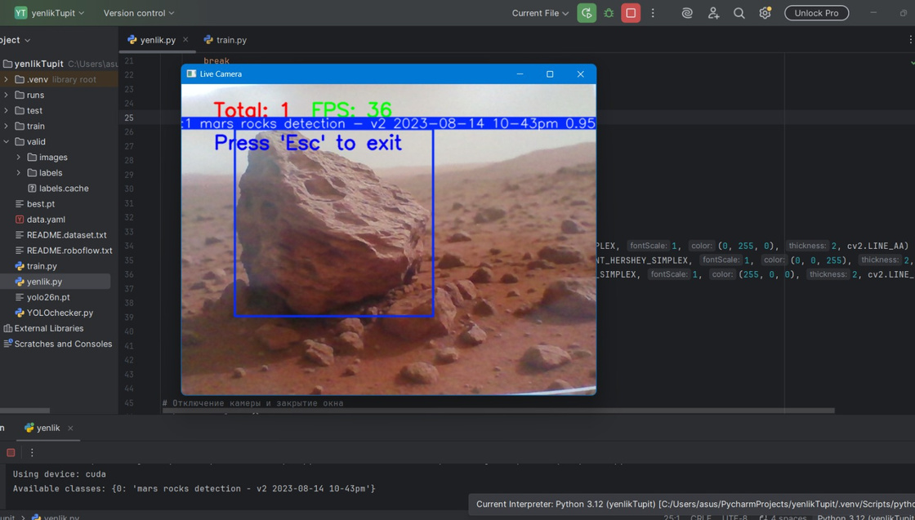
Ai application
How we use AI in our robot:
Autonomous navigation using a neural network
Obstacle detection (rocks, terrain irregularities)
Data analysis of underground seismic signals
We use a pretrained YOLO26 model for real-time object detection.
The AI helps the rover recognize rocks and avoid obstacles while moving.
Why AI is important for Mars exploration:
Reduces human control delay
Works in harsh environments (dust storms, radiation, temperature changes)
Increases mission efficiency and safety
Enables autonomous scientific research

Slide 11
Problem Statement
Problem Statement
FUTURE SPACE MISSIONS FACE MAJOR CHALLENGES DUE TO LACK OF SUBSURFACE INFORMATION.
KEY PROBLEMS INCLUDE:
LikiSanctum is a space technology startup focused on the commercialization of an autonomous seismic exploration rover designed to study subsurface structures on planetary surfaces such as Mars and the Moon.
The rover uses seismic surveying to detect underground lava tubes, cavities, and water ice deposits. These underground structures are critically important for the safe construction of future space bases, research stations, and commercial space hotels.
The LikiSanctum rover provides space agencies and private companies with reliable subsurface data, enabling safe mission planning and reducing infrastructure and mission risks.
The startup aims to manufacture, license, and deploy seismic exploration rover systems for use in future planetary missions.
Problem 1: High cost of mission failure
Planetary missions cost between:
$500 million to $2.7 billion
-Failure due to poor site selection results in major financial losses.
Problem 2: Need for safe locations for future infrastructure
Future infrastructure includes:
•Moon bases
•Mars bases
•Scientific stations
•Commercial space hotels
These require stable and safe underground conditions.
LikiSanctum solves this problem by providing direct subsurface exploration.

Slide 12


Target Customers
Primary customers
Future customers
Space agencies:
•NASA
•ESA
•Roscosmos
•CNSA
These agencies require subsurface exploration systems for missions.
Companies developing:
•Space hotels
•Commercial lunar infrastructure
•Resource extraction missions
Secondary customers
Private space companies:
SpaceX
Blue Origin
Axiom Space
These companies plan future Moon and Mars missions.

Slide 13


Revenue Stream 1: Rover sales
-Sell rover units to space agencies and companies.
•Estimated price per rover:
$50 million – $150 million
Revenue Stream 2: Rover technology licensing
-License rover technology to mission developers.
•Annual licensing revenue:
$1 million – $10 million per customer
Revenue Stream 4: Data collection contracts
Provide subsurface exploration services as part of missions.
Revenue Stream 3: Mission integration contracts
Provide rover integration and mission support services.
•Contract value:
$5 million – $50 million per mission
Revenue Streams

Slide 14
Conclusion
LikiSanctum provides a practical and commercially valuable solution for subsurface exploration on the Moon and Mars. By enabling the detection of underground structures such as lava tubes and water ice, the rover helps space agencies and private companies select safe locations for missions and future infrastructure, including space bases and hotels. This reduces mission risk, prevents costly failures, and supports the safe expansion of commercial space activities. With Kazakhstan’s strategic position in the global space industry, LikiSanctum has strong potential to become a valuable technology for future planetary exploration and infrastructure development.

Slide 15
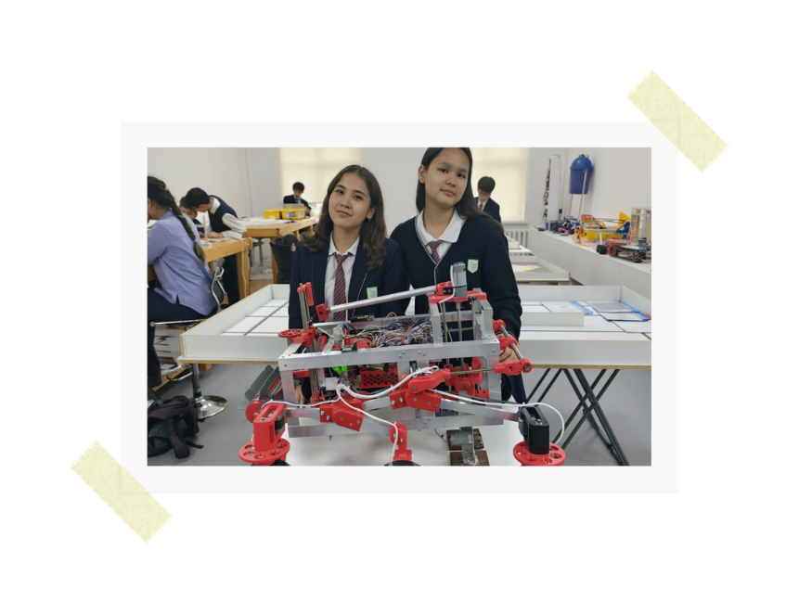

OUR team
Yenlik Maman
is responsible for the robot’s hardware development, programming, and electronics integration.
Saniya Shokhan
is responsible for the 3D modeling of the robot, mechanical design and hardware support, as well as documentation and project planning.
you may watch our pitch video by scaning this video

